Slide 1
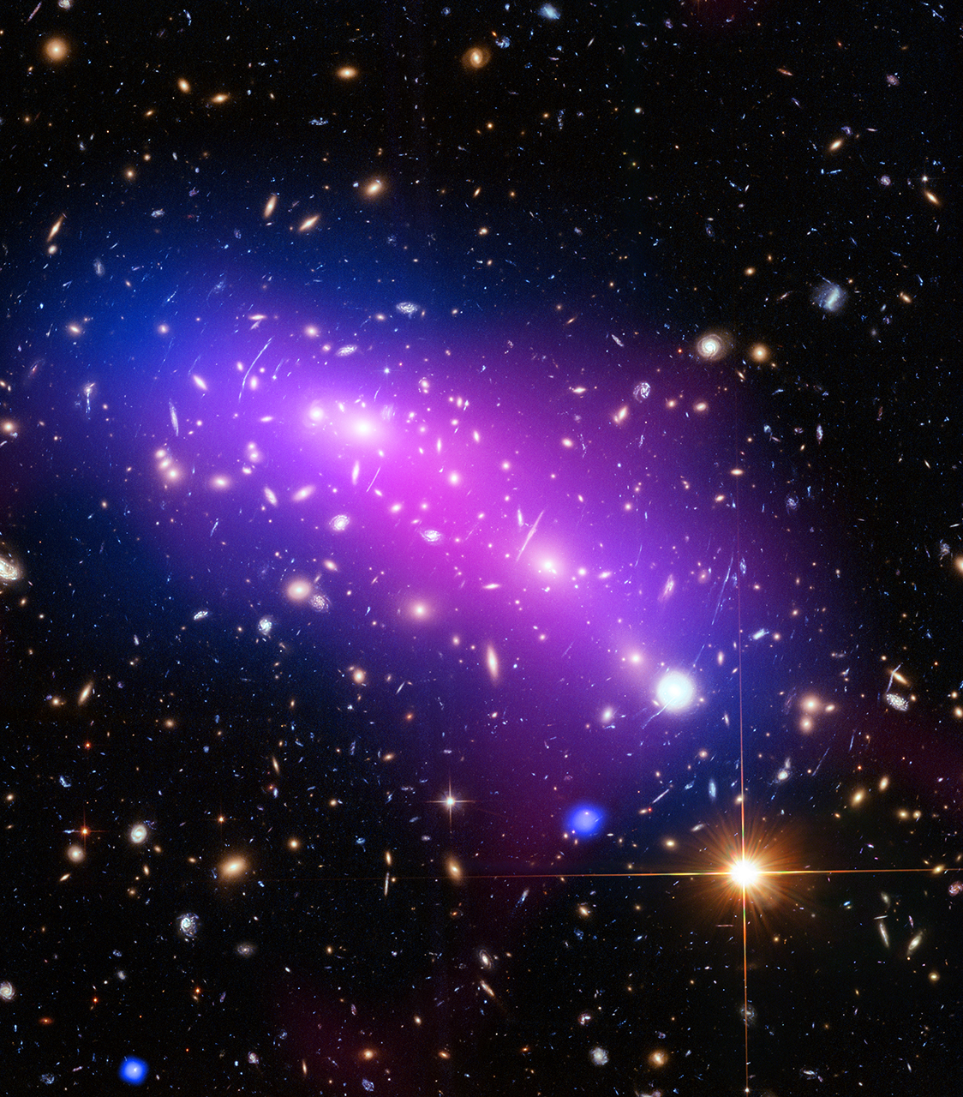
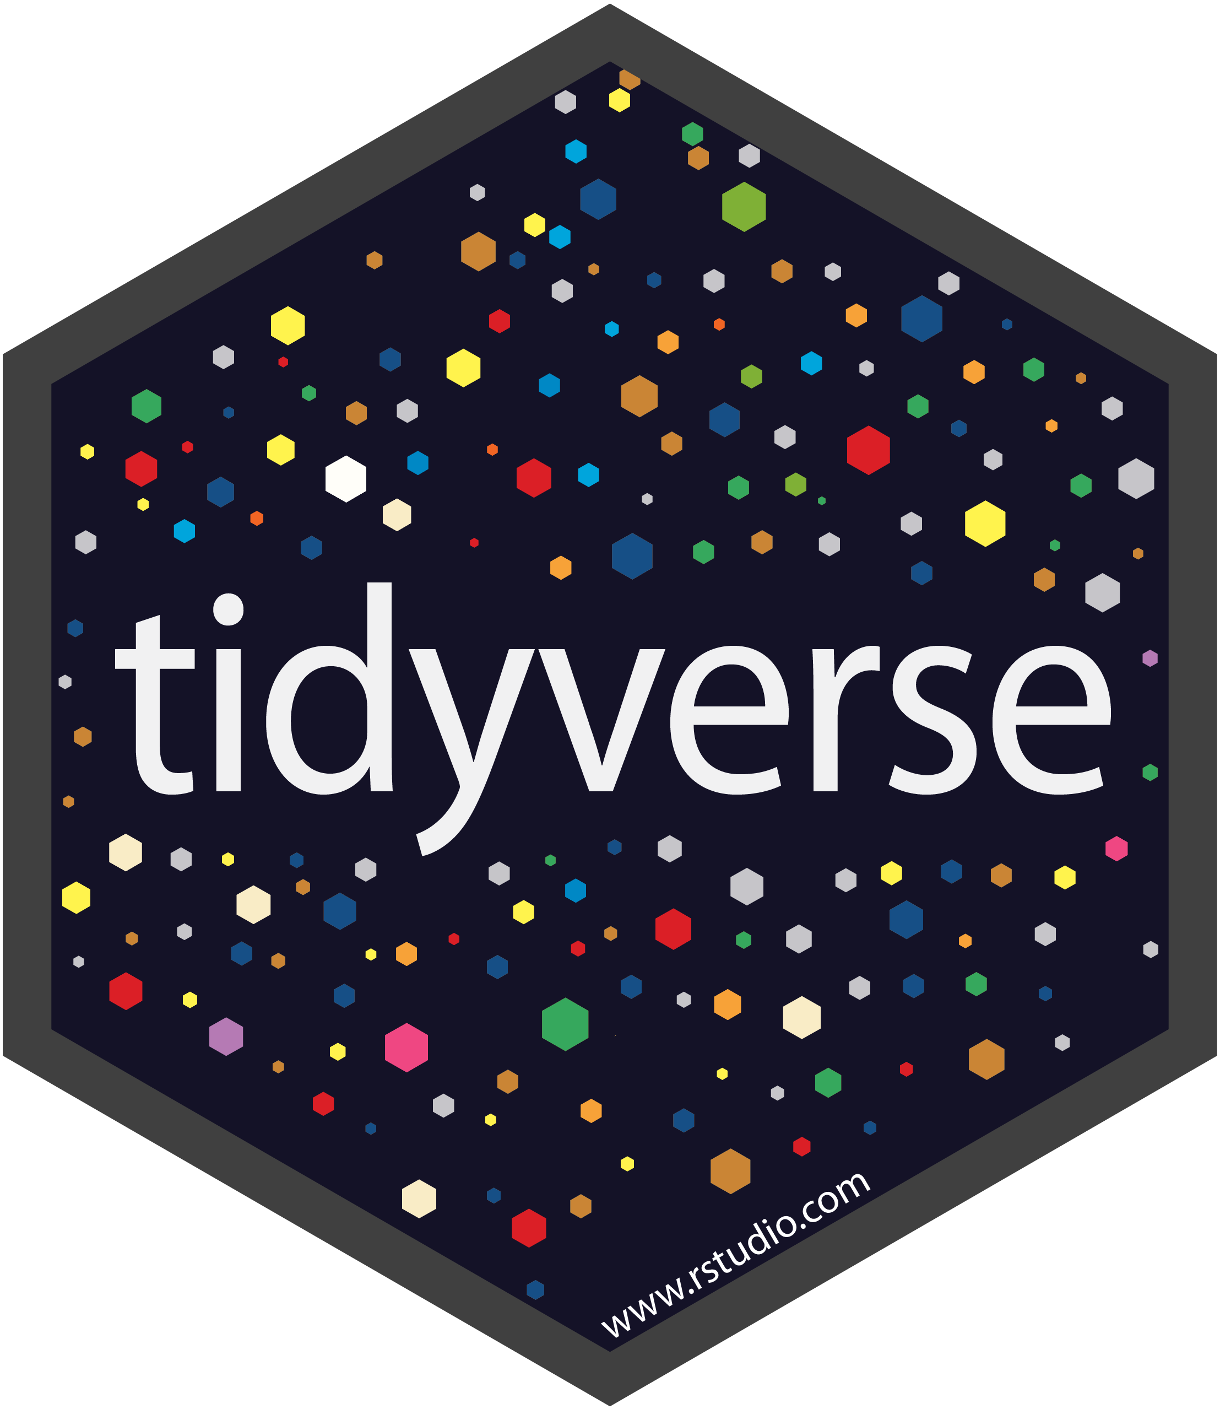
Welcome, to The
Mark Adkins
Institute for Social Research York University

Slide 2

functions
Functions are the backbone in R
We’ve seen many examples of functions:
filter()
read_csv()
mean()
Sometime it can be helpful to write our own functions
As a general rule, if you are copying and pasting your code more than twice, you should be using a function

Slide 3
Functions - template
To create functions within R we can follow a template like this: > function_name <- function(argument_1, …) { # R code return(result) }
Function components:
Name, arguments, body, return value

Slide 4
Functions - template
Function names should be verbs
They should provide a good description of what the function does for us
e.g. get_mean()
Function arguments should be nouns
Arguments are typically the data we want to perform some action upon or details that alter how the action is performed
e.g. data, conf.level, na.rm, etc

Slide 5
Functions - example
> get_mean <- function(num_vec) { # calculate the mean of a vector sum(num_vec) / length(num_vec) }
The last statement evaluated inside the body of the function is the value/object that is returned by the function
You can also use the return() function to exit a function early

Slide 6
Better Functions
While all you NEED to create a function are the components we discussed already, there are other things to consider to make our functions better
Argument checking:
Explicitly check assumptions about arguments
Conditional execution:
We discussed last week about using conditional statements (i.e., the if() function) to change which chunks of code are executed

Slide 7
Better Functions - argument checking
Questions to ask when argument checking:
What happens if the wrong data type/structure is passed?
What about missing data?
What about vectors of length 0?
Are there sensible defaults for some arguments?

Slide 8

Better Functions - argument checking
In our get_mean() example, let’s check out a few assumptions about our function argument: HINT: use the stop() function to is our own error message
num_vec is numeric (integer or double)
num_vec is a vector
The vector is not empty
There are no missing values

Slide 9


Data analysis Workflow

Slide 10

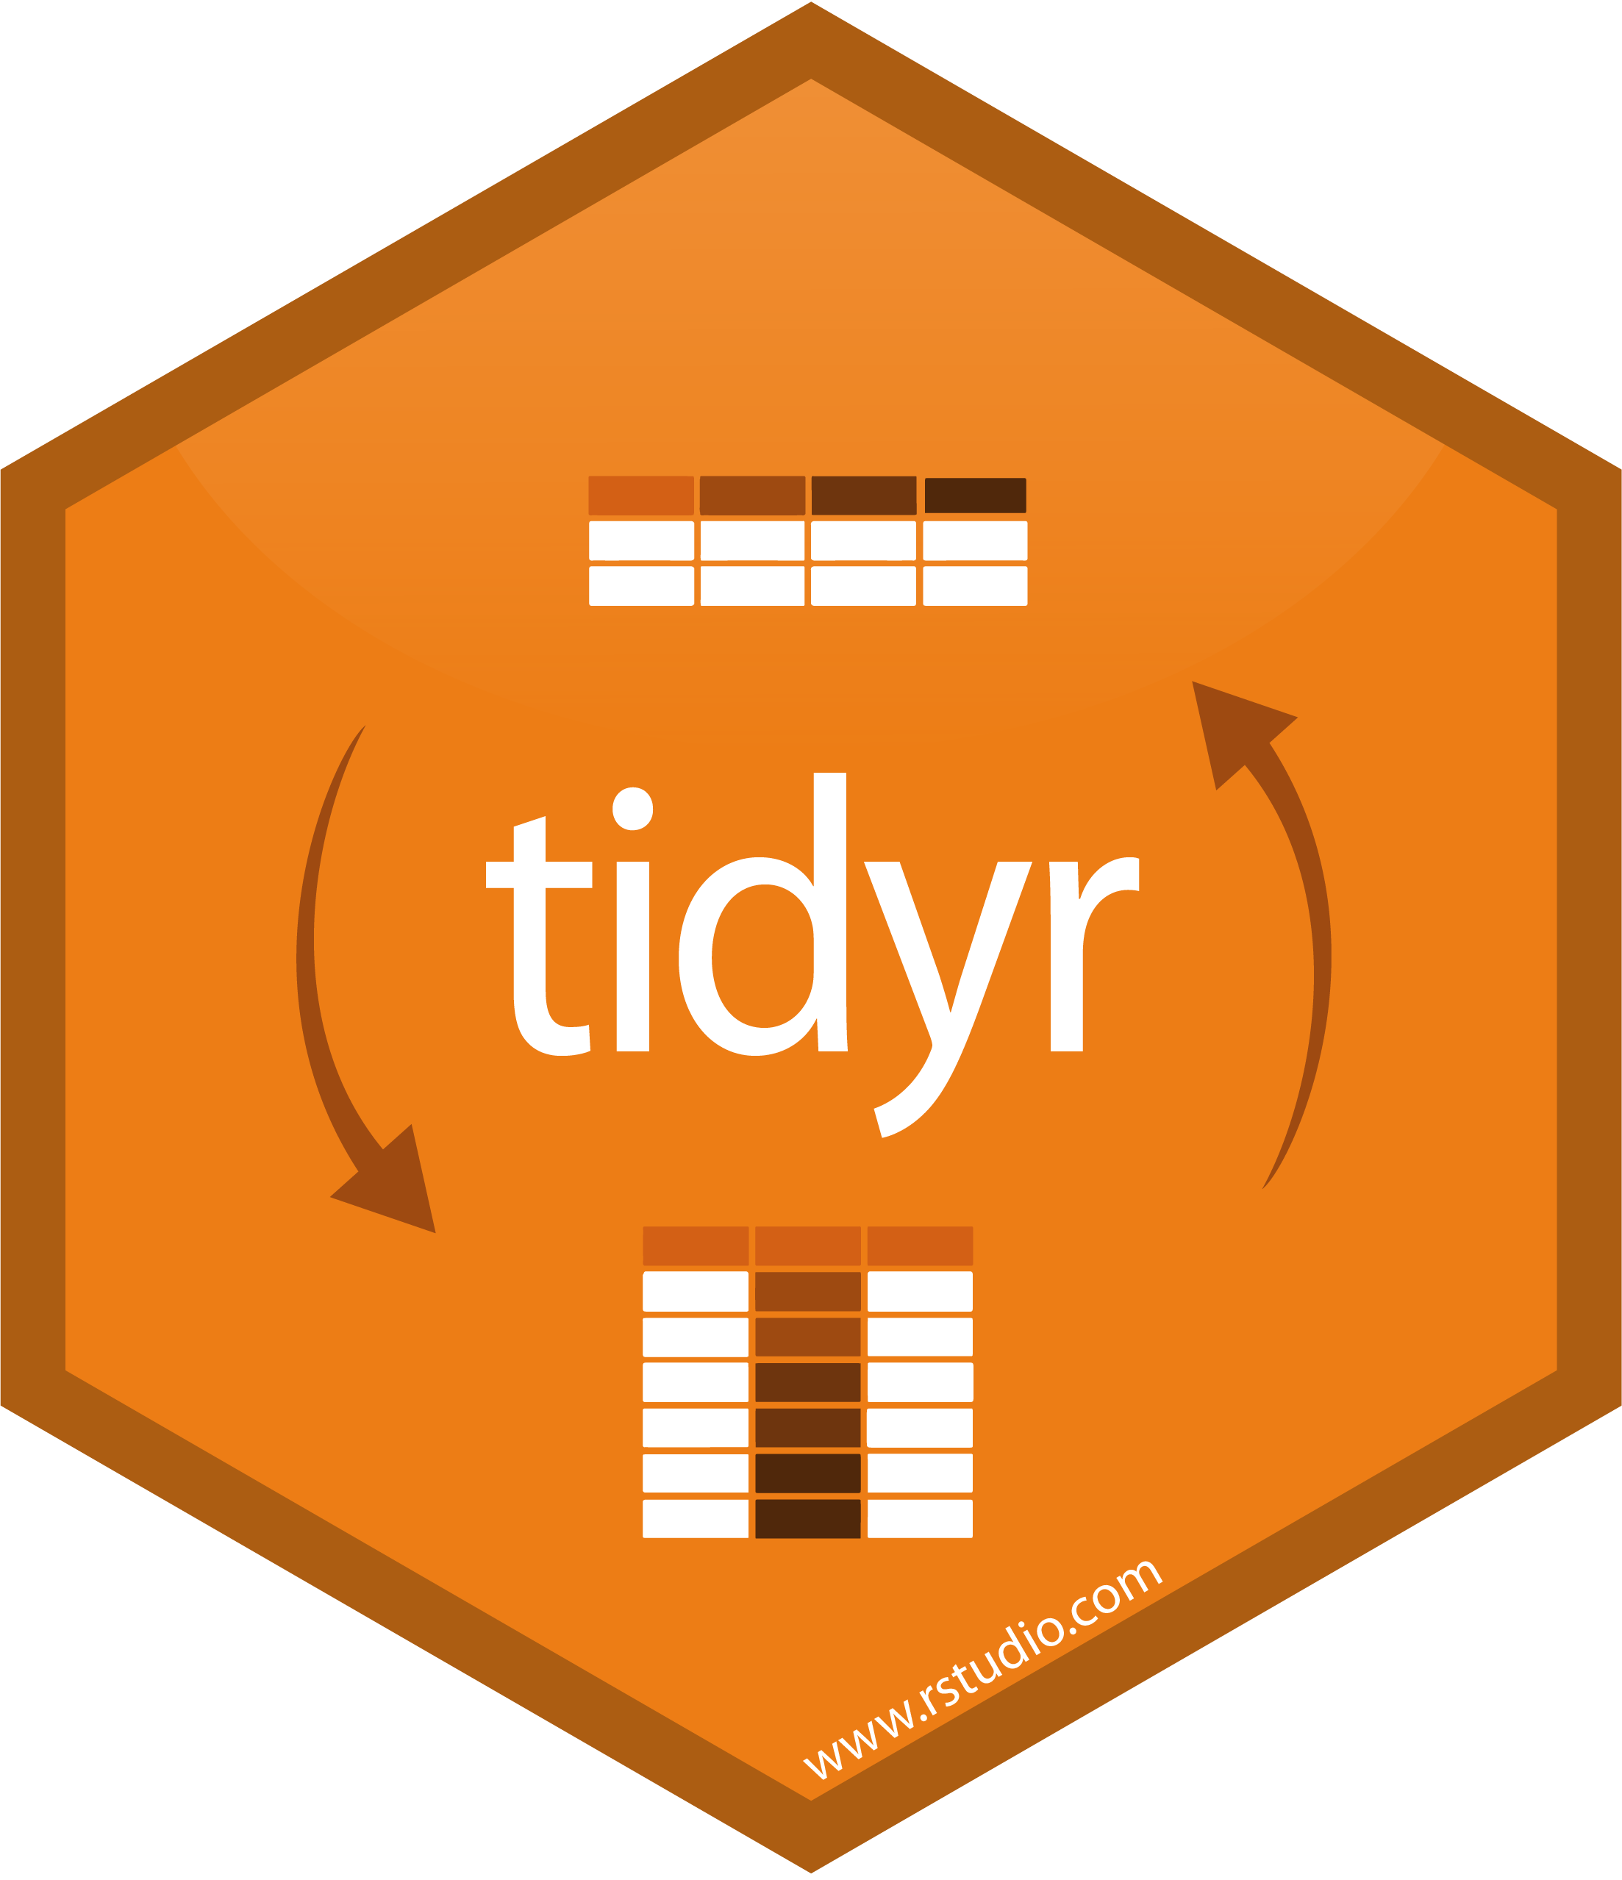

Data analysis Workflow - Wrangling

Slide 11
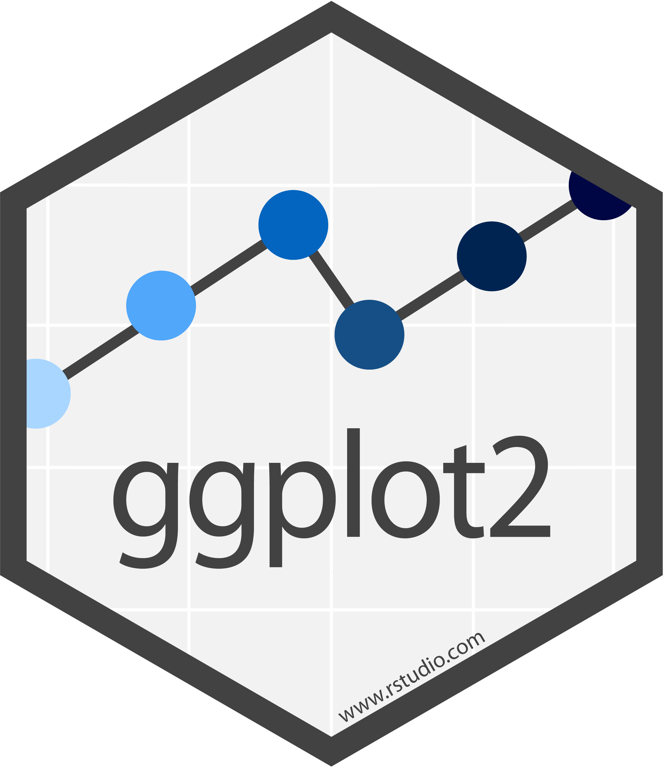
Data analysis Workflow - visualise

Slide 12
Tidyverse - visualisation
ggplot2 is an extremely flexible package for creating graphics in R
It’s a bit complicated at first, but the quality of visualisations which can be made are astounding
For examples (with full R code), check out this link: http://zevross.com/blog/2014/08/04/beautiful-plotting-in-r-a-ggplot2-cheatsheet-3/#add-a-title-ggtitle-or-labs http://r-statistics.co/Top50-Ggplot2-Visualizations-MasterList-R-Code.html

Slide 13
Tidyverse – ggplot function
Each graphic produced using ggplot2 begins with the ggplot() function
This function initializes a ggplot object, and usually the first argument passed is the data you will be using: > ggplot(data = superhero_data)
If you run this code, the ggplot() function will create a completely blank canvas because we have not yet told it how we want to display the data

Slide 14
Tidyverse – mapping aesthetics
The ggplot() function (and others within the ggplot2 package) can also take an argument called mapping
This argument is how we tell the ggplot() function to “map” variables within our data to different aesthetic aspects of our visualisations
e.g., x-axis, y-axis, shape, size, color, fill, group, etc.
Check out this link for more details about aesthetics: https://ggplot2.tidyverse.org/articles/ggplot2-specs.html#colour-and-fill

Slide 15
Tidyverse - example
Let’s add some axes to our visualization by mapping Weight onto the x-axis and Height onto the y-axis: > ggplot(data = superhero_data, mapping = aes(x = Weight, y = Height))
Now, instead of a blank canvas we created a coordinate system with an x-axis and a y-axis
But we still don’t “see” our data anywhere!

Slide 16
Tidyverse – geometric layers
In order to “see” our data, we need to add layers of geometric objects so that the ggplot() function knows exactly how we want the data drawn onto our canvas
All geometric layers start with a common prefix to make them easier to find: geom_*
A few examples of geometric layers: geom_point(), geom_line(), geom_smooth(), geom_text(), etc…

Slide 17
Tidyverse – geometric layers
We add layers AFTER the ggplot function by using operator “+”
We can add as many layers as we like: ggplot(data = …, mapping = aes(…)) + geom_* + geom_ * +
Each layer can have it’s own mapping argument, but if one isn’t provided, it inherits the mapping from the ggplot()

Slide 18
Tidyverse – geometric layers
We can also manually set an aesthetic of a geometric layer by including it as a named argument, but it must be OUTSIDE the aes() function
For example: I want to make all of the points in the plot to be blue: ggplot(……) + geom_point(color = “blue”)

Slide 19
Tidyverse – scatterplot
Let’s add some points to our visualization by adding a geometric layer to create a scatterplot > ggplot(data = superhero_data, mapping = aes(x = Weight, y = Height)) + geom_point()

Slide 20
Tidyverse – scatterplot
Let’s add another layer with the best-fitting regression line to our scatterplot
HINT: geom_smooth() > ggplot(data = superhero_dat, mapping = aes(x = Weight, y = Height)) + geom_point() +
How else can we improve this plot?

Slide 21
Tidyverse – trouble shooting
Here are some tips to keep in mind:
The initial ggplot() function should be a complete expression before adding any layers
Each layer is added using the “+” operator which MUST appear at the end of each line before the layer you want to add
Aesthetic mappings defined in ggplot() are passed down to subsequent layers

Slide 22
Tidyverse – position adjustments
Often, our graphs can depict overlapping information, especially in histograms
We can tell ggplot how to adjust the position of our geom layers in order to void obscuring our data
We can adjust how geom layers are positioned by altering the position argument
We can either supply a string (e.g., “dodge” or “stack”) or use a position function

Slide 23
Tidyverse – position adjustment functions
position_dodge()
Adjusts the horizontal position while retaining the vertical position
positon_jitter()
Adds random noise to avoid complete overlap of geom shapes (can jitter on x, y, or both axes)
positions_jitterdodge()
Applies a dodge and jitter position adjustment
position_nudge()
Usueful to adjust items on a discrete scale by a small amount (useful for labeling)

Slide 24
Tidyverse – histogram
Let’s practice building a plot from scratch which might benefit from using position adjustments
Try creating a histogram to explore how the distribution of superhero Height differs by Gender (use the cheat sheet to find an appropriate geom)
What type of position adjustment might make these distributions more distinct and clearer?

Slide 25
Tidyverse – faceting
While position adjustments make our plots clearer, we might want a separate panel for different levels of our variables
This is done easily by adding a faceting layer to your plot
Facet into columns
facet_grid( . ~ var_1)
Facet into rows
facet_grid(var1 ~ . )
Facet using both columns and rows
facet_grid(var1 ~ var_2)

Slide 26
Tidyverse – faceting
Faceting can also accomplished using the facet_wrap() function
facet_wrap(~ var_1)
You can override the dimensions of the panel layout by adding other parameters to the facet_wrap() function
nrow
ncol
By default the x and y scales are “fixed”, but they can be freed (check the help documentation)

Slide 27
Tidyverse – faceting example
Create a scatterplot depicting the relationship between superhero Height and Weight, but this time facet using superhero Alignment (as the columns) and Gender (as the rows)

Slide 28
Tidyverse – labels
Labels are added to ggplots using the labs() function
They are added as another layer
ggplot(data = superhero_dat, aes(x = Weight, y = Height)) + geom_point() + labs(title = “Superhero Heights and Weights”)
Try changing the axes labels to indicate the units of measurement for Height (cm) and Weight (lbs)

Slide 29
Tidyverse – themes
Ggplot2 uses themes to alter the appearance of practically any aspect of the plot itself (labels, fonts, background panel, etc)
There are a few nice defaults, but you might want to create your own
This is done using the theme function which is added as another layer to your ggplot
Themes can be saved for later use!

Slide 30
Tidyverse – themes examples
> ggplot(data = superhero_dat, aes(x = Weight, y = Height)) + geom_point() + theme_bw()
> ggplot(data = superhero_dat, aes(x = Weight, y = Height)) + geom_point() + theme(plot.title = element_text(face = “bold”, hjust = .5))

Slide 31
Tidyverse – saving plots
Any plot we create using ggplot2 can be saved within R as an object by using the assignment operator > superhero_height_hist <- ggplot(…)
Once we have created a ggplot object we can easily add additional layers using the “+” operator
superhero_height_hist <- superhero_height_hist + geom_*

Slide 32
Tidyverse – saving plots
I recommend creating a subdirectory to make it easy to find your plots (do this manually within your R project directory)
We can export a ggplot using the ggsave() function
>ggsave(filename = “plots/Hist.jpeg”, plot = superhero_height_hist)
The ggsave() function let’s you specify the units, dimensions, resolution, image type, and many other aspects of the plot

Slide 33
Choosing appropriate plots
This is a fantastic resource to help you choose which plots to create to explore your data or tell a story with your data! https://www.data-to-viz.com/

Slide 34
Extra topics
gghighlight
addins for ggplot2
Rmarkdown

Slide 35
Tidyverse – scratching the surface
So we have covered many, many, many topics, but we have only scratched the surface of using R and the tidyverse collection of packages
Feedback?
Thank you for participating!!!

